Slide 1

Towards Machine Learning-based Autism Spectrum Detection and Management Using Multimodal Data
Submitted by:
Silvia Binte Nur(172463)
Md. Farhad Hossain (172506)
Sabbir Ahmed (172516)
Supervisor:
Dr. M. Shamim Kaiser
Professor,
Institute of Information Technology
Jahangirnagar University

Slide 2
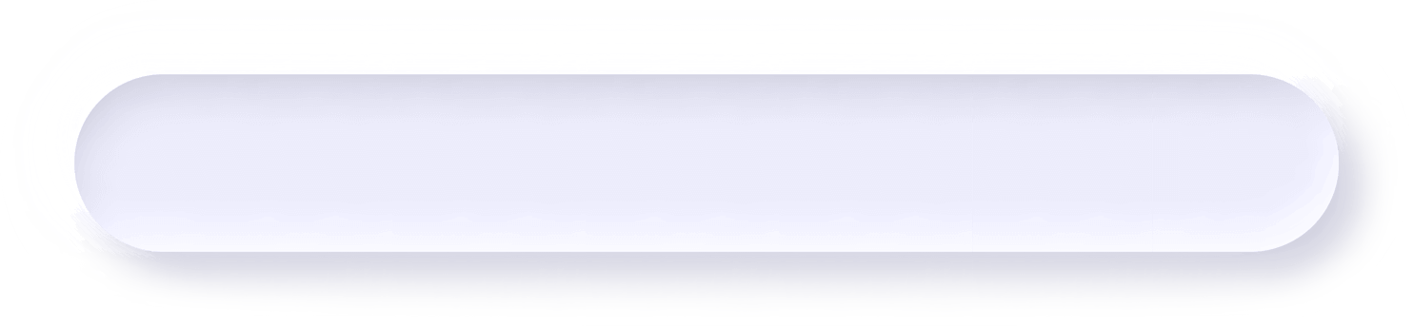

Outline
Introduction
Problem Statement
Research Gap
Motivation
Objective
Literature Review
Proposed Methodology
Questionnaire
Multimodal Screening
ASD Monitoring
Conclusion

Slide 3
INT
R
ODU
C
T
ION

Slide 4
Autism Spectrum Disorder (ASD)
Autism spectrum disorder (ASD) is a complex developmental condition involving persistent challenges with social communication, restricted interests, and repetitive behavior
Source : CDC

Slide 5
Autism Spectrum Disorder (ASD)
Screening
Difficulties
Traditional
Screening
Computational
Screening
Diversity in symptoms
few visible physical impairments
Significant psychological sickness
no quantifiable lab test attributes
detailed developmental history from parents
observation of the child’s interactions
combination of structur- -ed and unstructured assessment
Questionnaire, eye track , neuro-imaging etc.
Faster prediction for Complex characteristics and symptoms
Assist professional for decision making

Slide 6
Motivation
01
40% of people with ASD are nonverbal,
31% of children have an intellectual disability
02
Lifetime cost of ASD
Medical Approaches required experienced professional, and relatively long time
$3,600,000
Source : ScienceDirect
03
Early Intervention, continuous monitoring will improve quality of life significantly

Slide 7
Problem statement
Finding out possible cause and symptoms of ASD
Earlier reliable ASD Screening
Patient health data availability to doctors and care giver

Slide 8

Research Gap
Limited data set based on questionnaire. No available detail analysis of possible symptoms Multimodal datasets
Most of the ML based
ASD Screening have one , at most 2 to 3 modality. Multi-Modal Classification Architecture is not present.
Appropriate list of the all possible symptoms related to ASD according to literature is not available

Slide 9
Objectives
To create questionnaire and multimodal data collection strategy
To collect ASD dataset using questionnaire and multimodality
To design ML classifiers and multimodal neural networks for ASD classification.
To evaluate ML classifiers for ASD classification and multimodal neural net works for screening.
To compare Classifiers for screening and type detection.

Slide 10
Contribution
Accumulated symptoms related to ASD
Created screening methodology from relevant symptoms
Prepared a multimodal dataset with eye scan path, face, behavior, activity, audio data
ASD screening , type detection from questionnaire using machine learning.
Designing a multimodal Neural network that encompasses all factors into screening
Utilized a device that contains several sensors (Fitbit) to monitor ASD patients
On the created dataset, we have compared various multimodal classifiers.

Slide 11
LITER
A
TURE
--
R
EVIEW

Slide 12
ASD Screening Using ML
Author
Title
ML Model
Data Type
Evaluation
Limitation
Goel et al.
2020
Modified Grasshopper Optimization Algorithm for detection of Autism Spectrum Disorder
GOA, , LR, NB, KNN,
RF-CART & ID3, BACO
AQ-10, Questionnaire
Accuracy of near 100%
Low convergence speed for GOA, computationally very expensive
Thabtah & Peebles. 2020
A new machine learning model based on induction of rules for autism detection
RIDOR, Nnge, RIPPER, RML, Bagging,
CART, PRISM & C4.5
AQ-10, Q-CHAT, Questionnaire
F1-Score 90%
Not applied to any toddler dataset
Levy et al.
2017
Sparsifying machine learning models identify stable subsets of predictive features for behavioral detection of autism
LR, Lasso, SVM, ADTree, RF, Ridge, Elastic net, LDA, AdaBoost, R-Lasso
ADOS, Questionnaire
AUC 95%
Impure source and survey of data
Carette et al.
2019
Learning to Predict Autism Spectrum Disorder based on the Visual Patterns of Eye-tracking Scan paths
RF,SVM,LR,NB,ANN
Eye Tracking
AUC 90%
Exclusion of Comparison with other NN

Slide 13
ASD Screening Using ML
Author
Title
ML Model
Data Type
Evaluation
Limitation
Tao et al.
2019
SP-ASDNET: CNN-LSTM based ASD classification model using observer
SalGAN, CNN-LSTM
Eye Tracking
Accuracy 74.22%
Limited dataset, high network complexity
Chen et al.
2019
Attention-based Autism Spectrum Disorder Screening with Privileged Modality
CNN,RNN,LSTM
Image
95% accuracy
Did not applied on any public dataset
Tang. 2020
Deep multimodal learning for the
diagnosis of ASD
CNN,MLP
image, fMRI
Accuracy 74%, F1-Score 80.5%
Low accuracy, limited data
Li 2020
Classifying ASD children with
LSTM based on raw videos
LSTM
Video
Accuracy 92%
Angle of camera has significant effect on misclassification

Slide 14
ASD Screening Using ML
Author
Title
ML Model
Data Type
Evaluation
Limitation
Sadiq et al.
2019
Deep learning based multimedia
data mining for ASD diagnosis
CNN,LSTM
Audio
Accuracy 84%
Lack of statistical measurements
Sun et al.
2020
Spatial attentional bilinear 3d convolutional network for video-based ASD detection
CNN,LSTM
Video
F1 Score 95%
Private dataset, Limited amount of data
Eldin et al.
2018
A Review of Wearable Solutions for Physiological
and Emotional Monitoring for Use by People with
Autism Spectrum Disorder and Their Caregivers
Reviews wearable devices that can monitor
physiological signals and markers of emotional states
Heart rate, EDA, temperature and 7 more
--
Bokadia et al.
2020
Digitized ADOS: Social Interactions beyond the Limits of the Naked Eye
Uses the Autism Diagnostic Observation Schedule to study social dyadic interactions, by combining observation with digital data from wearables
kinesthetic reafferent feedback
No wearable device were designed, only movement data were used

Slide 15
ME
T
HOD
O
L
GY

Slide 16
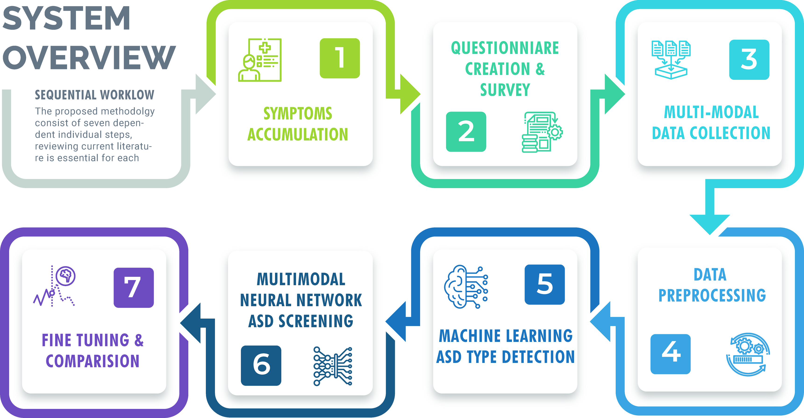

Slide 17
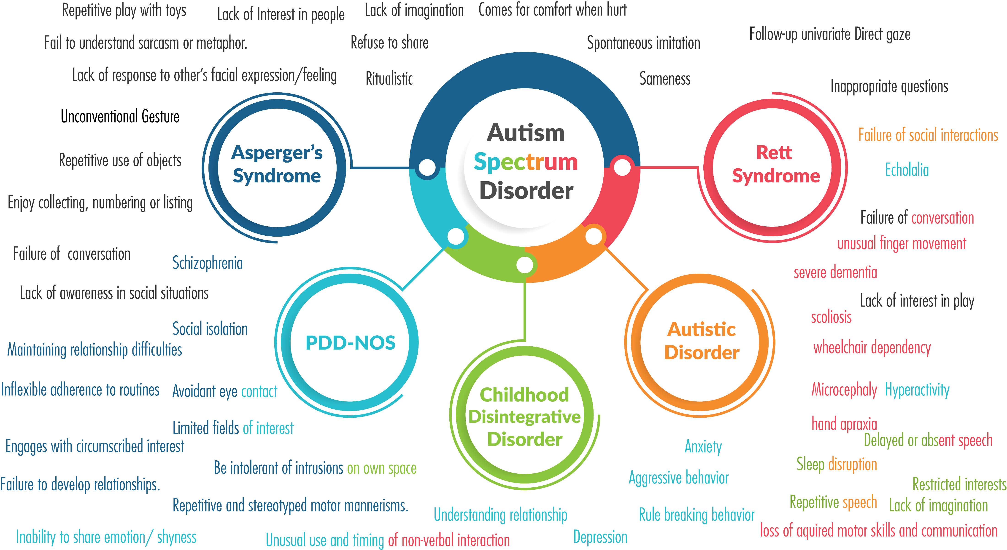
Symptoms

Slide 18
Questionnaire
The questionnaire consists of 24 questions, with 82 fields representing options for these questions. A sample Question Is Following :
Suppose you are in a family wedding | Representing Symptoms | Autism Type | Author
You feel disturbed when other relatives initiate conversation or want to capture a photo together. | Be intolerant of intrusions on own space | CDD, Asperger | Baskin et al- 2006, Malhotra et al- 1999
You hate social rules in weddings like dress code, table manners because you don’t like these rules! | Rule breaking behavior | PDD-NoS | Snow et al 2010
You feel awkward and don’t know what to do among all of these people. | Unable to adapt style of communication to social situations | ASD | Faras et al- 2009
You pretty much enjoy the festive vibe and unlimited supply of food. | Normal | - | Faras et al- 2009
You prefer to stay alone and enjoy solitude. | Social isolation | Asperger | Mirkovic et al -2019

Slide 19
Multi-modal Data – Feature Extraction
Video Data Extraction
Audio Data Extraction
Voice - Recorded audio using microphone
Optical Heart rate sensor – Sleep pattern, heart rate variability
GSR (galvanic skin response) - measuring the electrical conductance of the skin
Accelerometer : Sudden movement, fall detection, acceleration.
Gyroscope: to detect motion
Altimeter : Altitude calculation from sea level
SpO2 monitor to measure blood oxygen levels
Bioimpedance sensor to measure respiratory rate, sleep, etc.
Gesture sensors detect wrist motion Electrodermal activity sensor
Screening – Online Screening capabilities to assist doctors
Monitoring – Daily Monitoring of data collected from the patients.
Report & Suggestion– Improvement report, translation of collected data by machine.
Mini-game and task for ASD patients
Guidelines for caregiver

Slide 20
Dataset Details
Questionnaire
Audio Extracted
Total 71 data instances
42 men and 29 women
Age ranged from 4 to 27
Screening – Online Screening capabilities to assist doctors
Monitoring – Daily Monitoring of data collected from the patients.
Report & Suggestion– Improvement report, translation of collected data by machine.
Mini-game and task for ASD patients
Guidelines for caregiver
Video Extracted

Slide 21
ANN for ASD Classification
ANN Architecture with residual connection utilizes skip connections, or shortcuts to jump over some layers. This allowed to avoid the problem of vanishing gradients, or to mitigate the Degradation (accuracy saturation) problem; where adding more layers to a suitably deep model leads to higher training error.

Slide 22
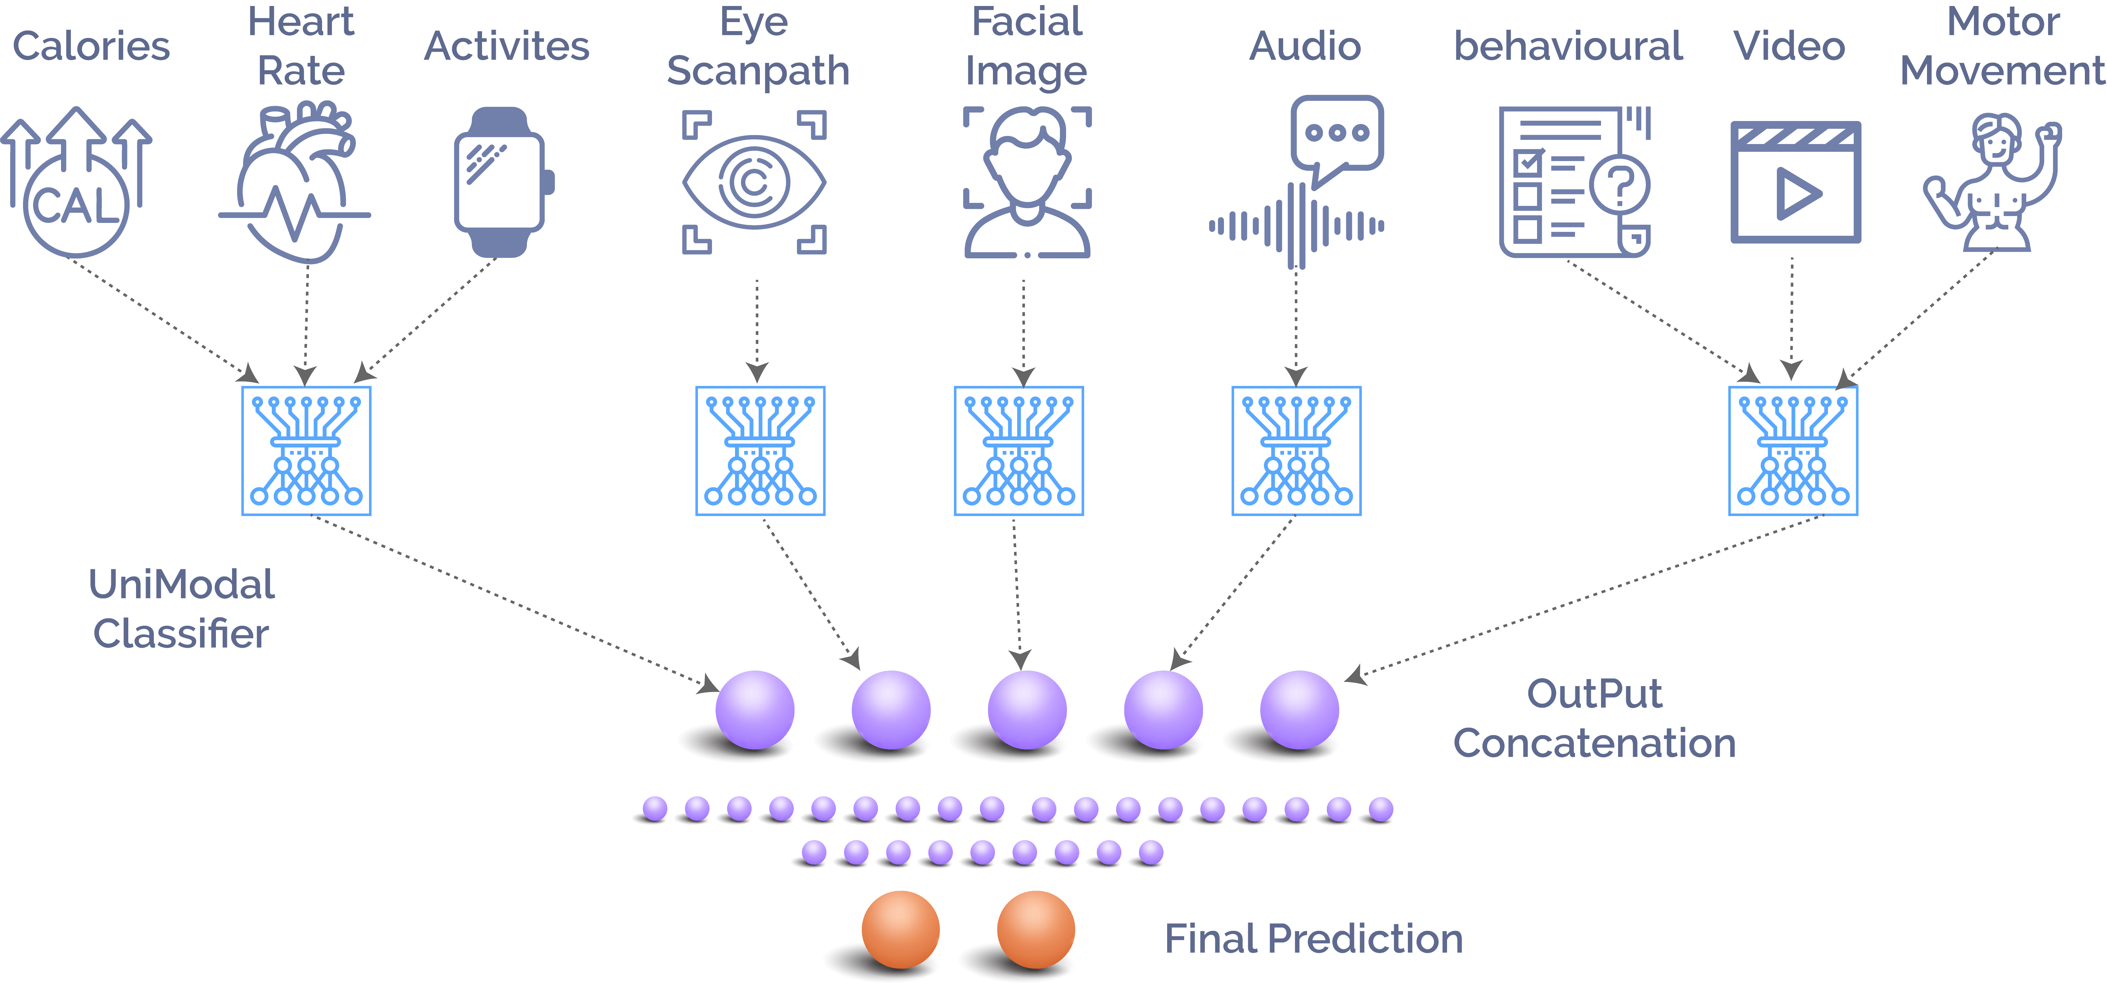
Multi-Modal Classification

Slide 23
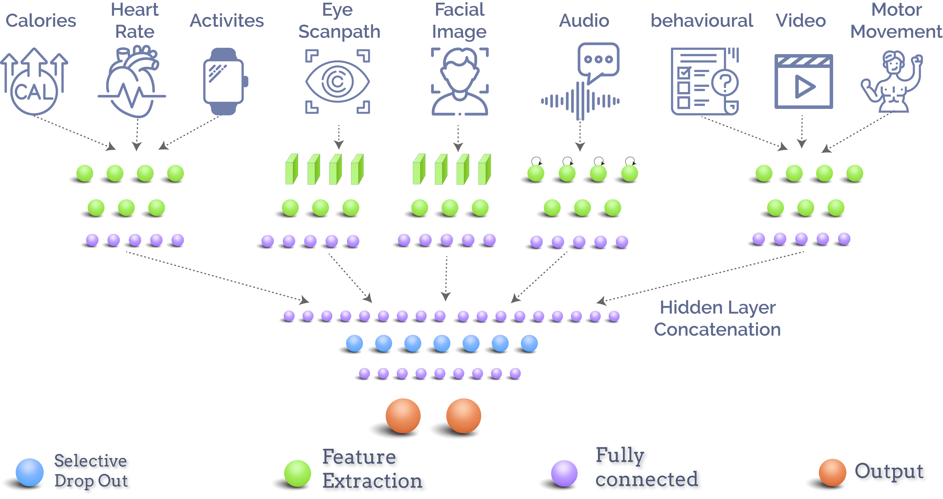
Multi-Modal Classification

Slide 24
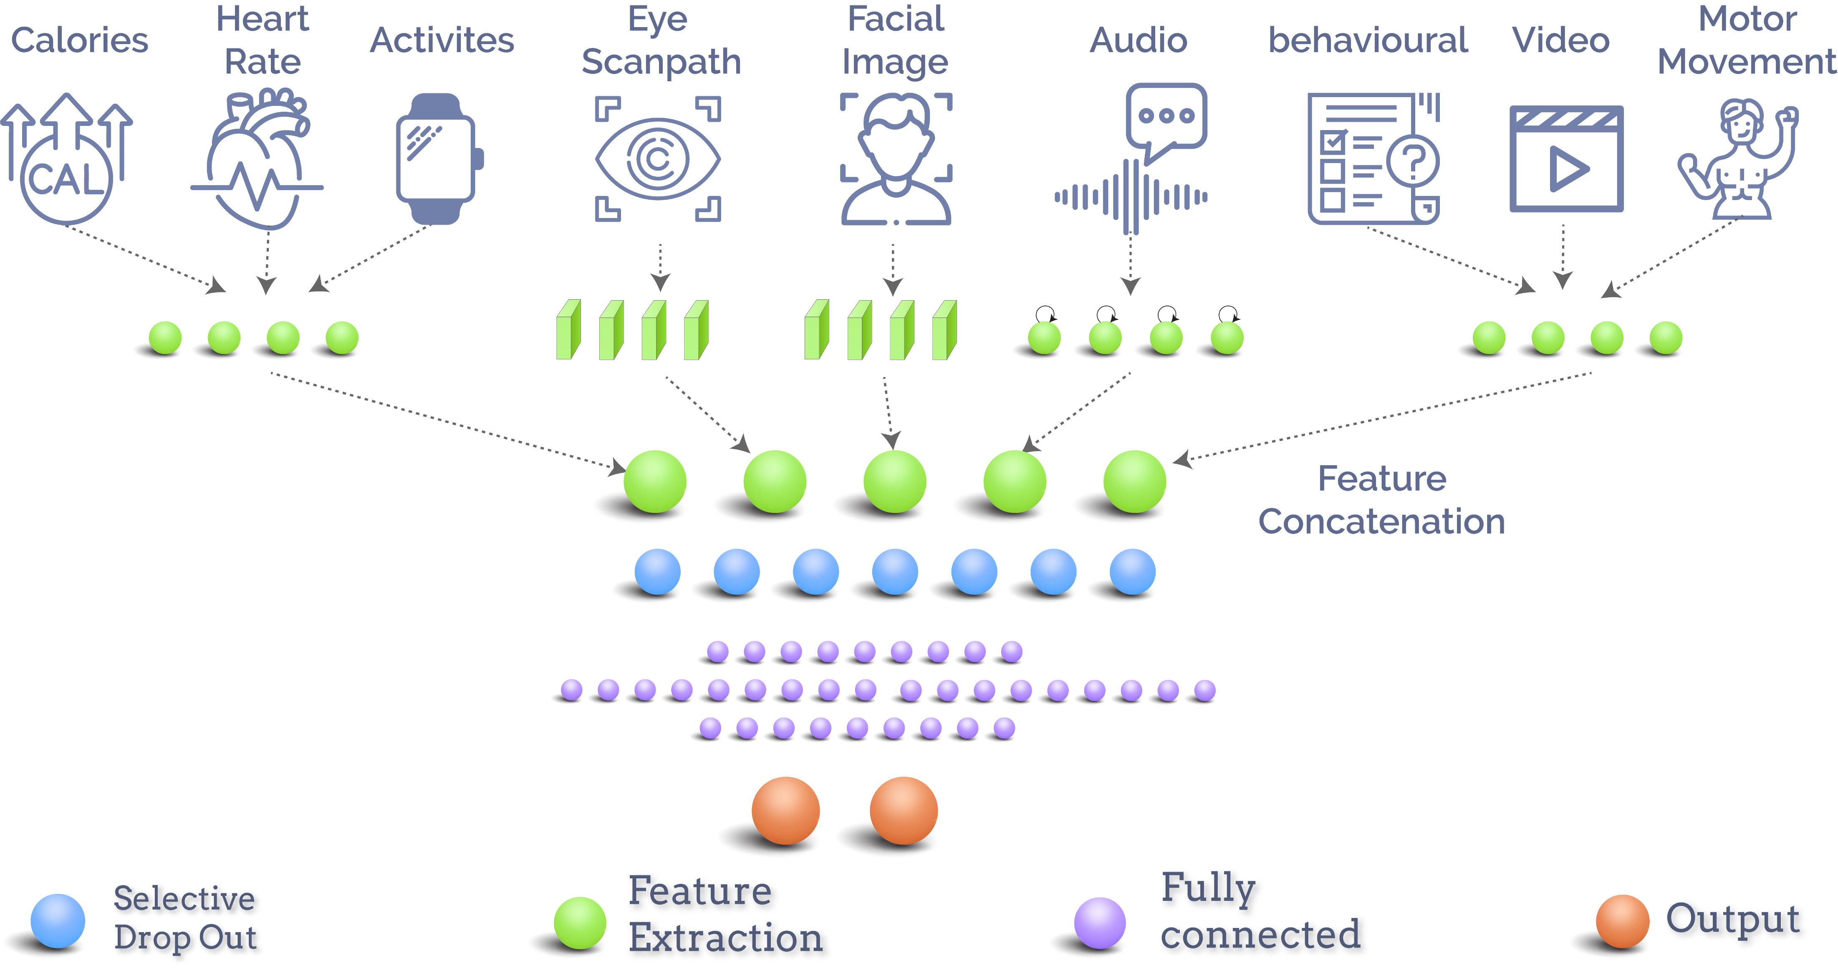
Multi-Modal Classification

Slide 25
Selective Drop Out

Slide 26
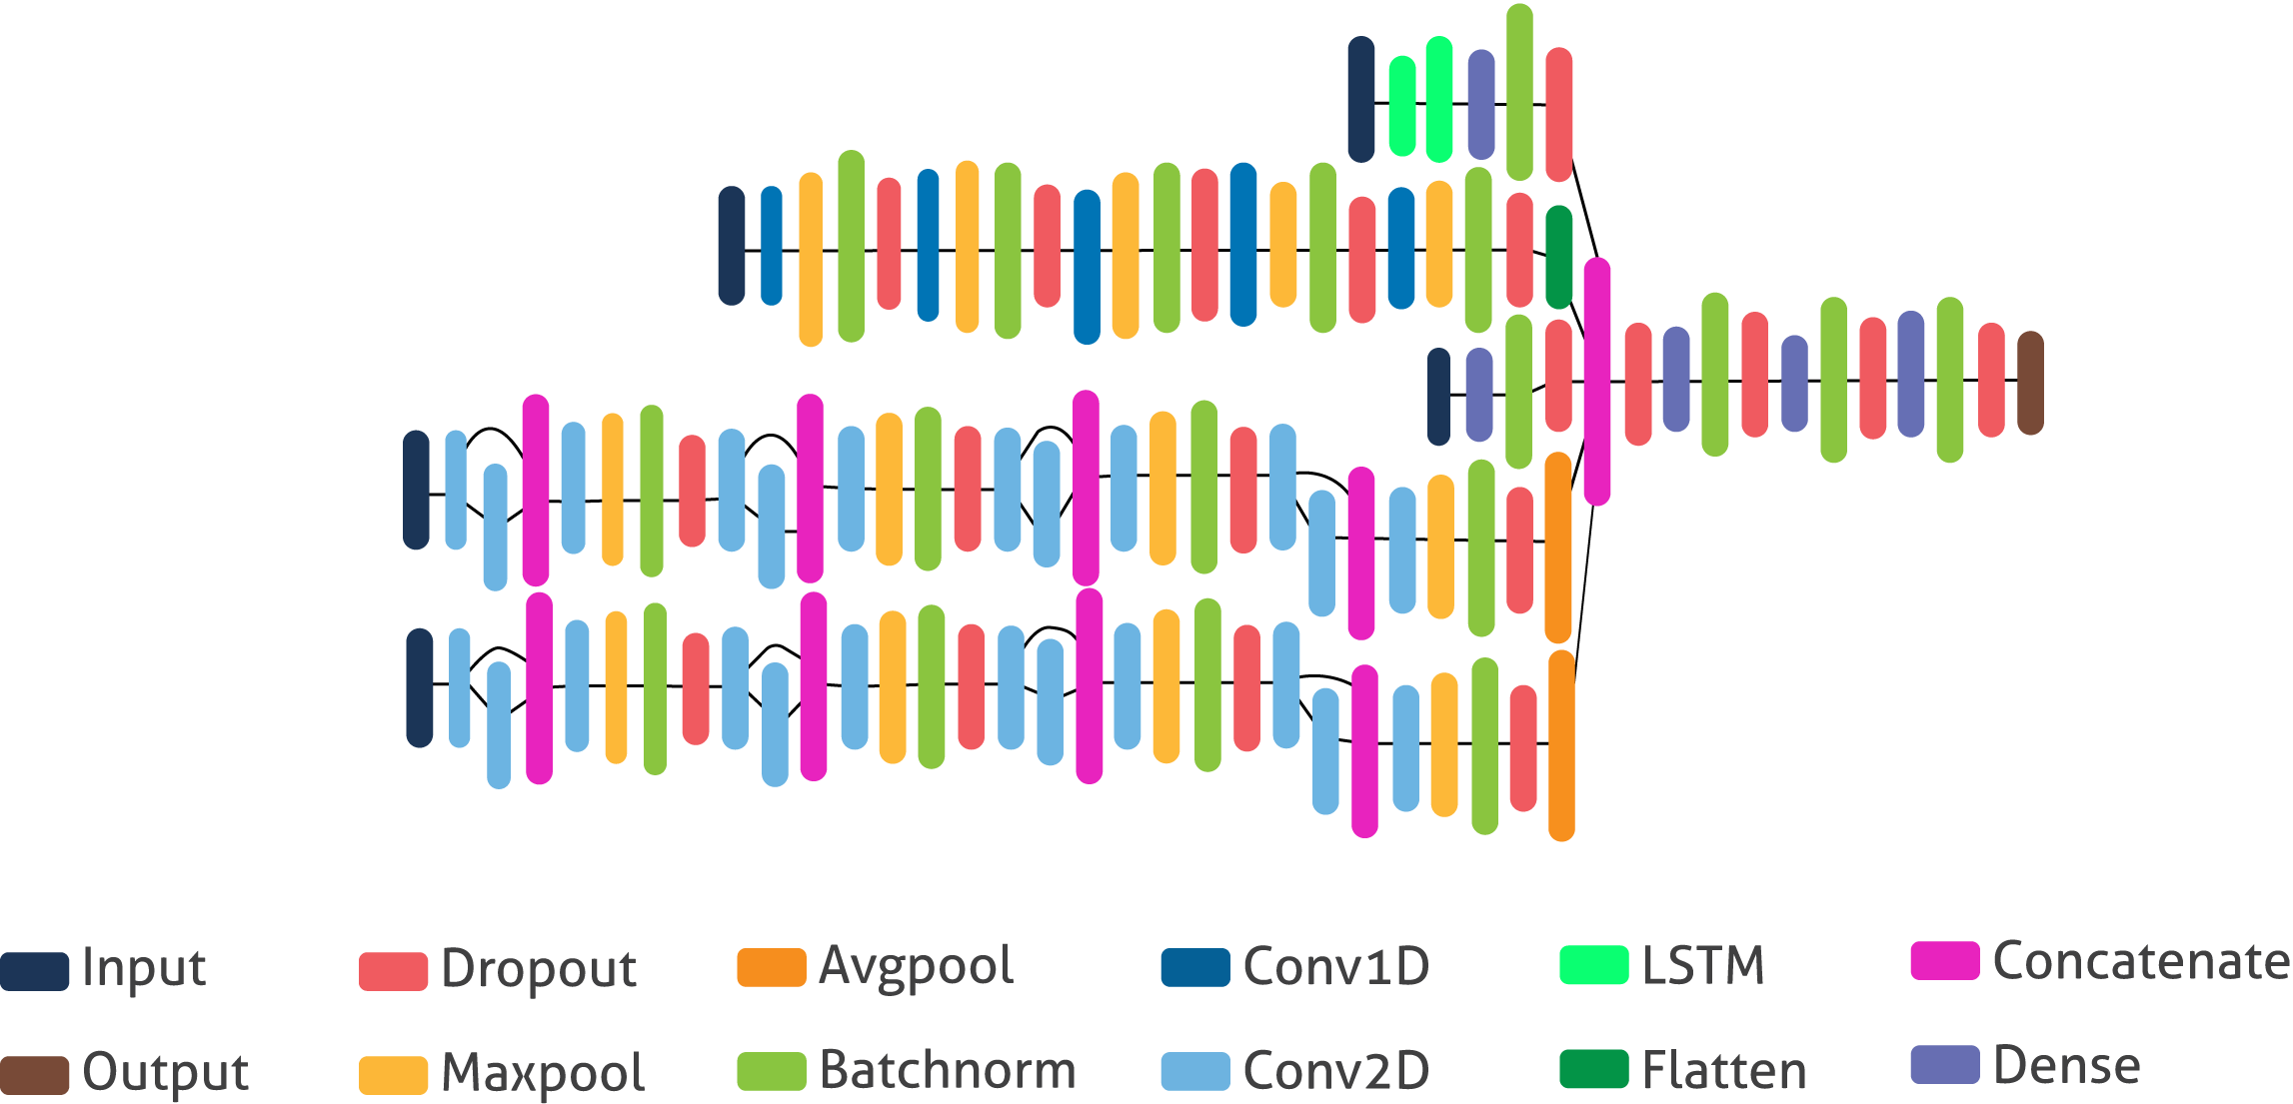
Proposed Multimodal Classifier
Audio Extracted
Video Extracted
Fitbit data
Eye Scan Path
Facial Image

Slide 27
P
ERI
EX
M
E
NT

Slide 28
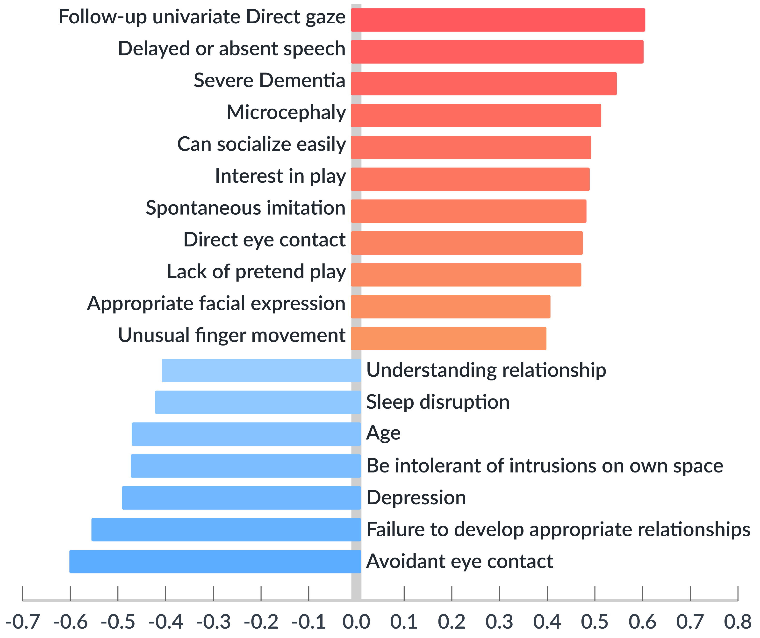
Experimental Analysis
The questionnaire consists of 24 questions, with 82 fields representing options for the questions.
Each of these options was then graded on a five-point scale.
Each of the field is related to one of the symptoms
ASD symptoms with most correlation in Survey

Slide 29
Experimental Analysis
Mean value of symptoms relevant to ASD types and neuro-typical

Slide 30
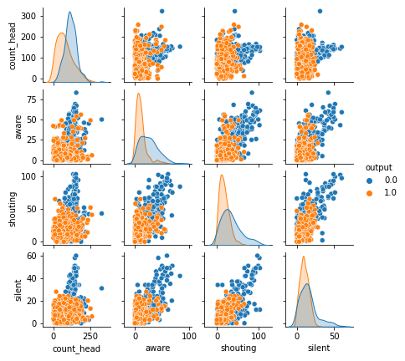
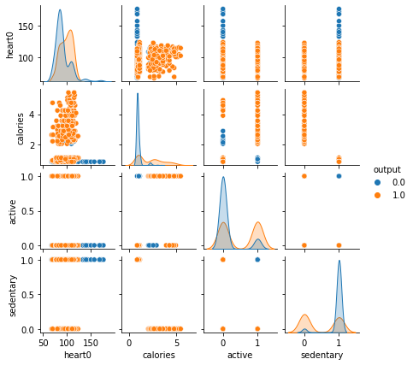
Experimental Analysis
Behavior and Fitbit Data Pair Plot to visualize relation with ASD and Neurotypical

Slide 31
Experimental Analysis
Comparison of performance metrics in testing data among ML classifiers for ASD type detection (Classification)

Slide 32
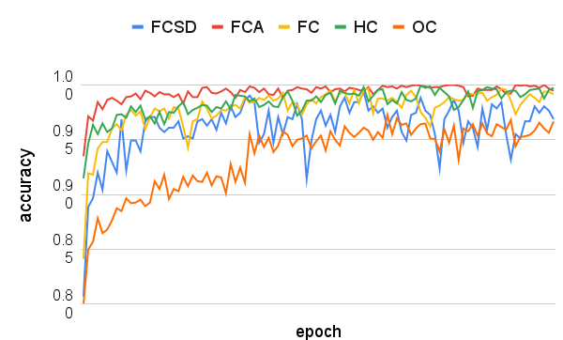
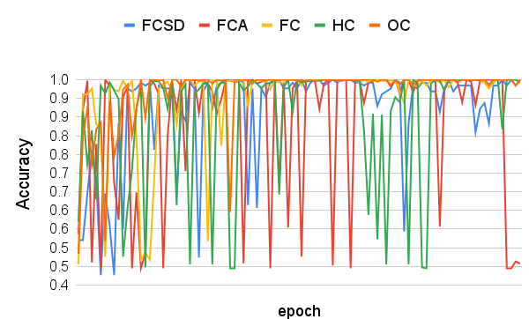
Experimental Analysis
Comparison of Accuracy among different Multimodal Technique
Train Accuracy
Test Accuracy

Slide 33
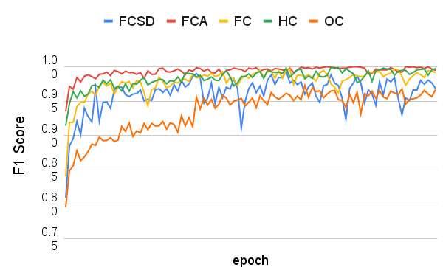
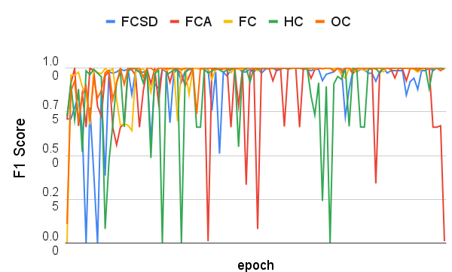
Experimental Analysis (Screening)
Comparison of F1-Score among different Multimodal Technique
Train F1-Score
Test F1-Score

Slide 34
Experimental Analysis
Comparison of Average Accuracy of last 25 Epoch among different Multimodal & Single Modality Classifier

Slide 35
Conclusion
The early and quick diagnostic method of ASD allows early intervention and medical treatment, which reduces the risk significantly.
We have discussed a wide variety of symptoms and screening criteria for ASD
A multimodal Neural Network Approach is proposed for ASD Classification
ASD monitoring system can be useful for tracking daily update of ASD Patient

Slide 36

Feel
Free to
ask Any
Questions

